Slide 1
AI-Based Vitiligo Image Analysis and Candidate Light-Region Estimation Using Image Processing
An Educational Image-Processing Prototype
B.Tech – Artificial Intelligence & Data Science
Academic Project – 2026–2027
Presented by: Shaik Bibi Arthika
AI-Based Vitiligo Image Analysis • Educational Prototype 1

Slide 2
1. Introduction
• Vitiligo is associated with lighter regions appearing on the skin.
• Manually observing and comparing such regions in multiple images can be difficult.
• This project presents an educational image-processing prototype for candidate light-region analysis.
• The system uses Python, OpenCV, NumPy, Pillow, Pandas, and Streamlit.
• It provides numerical and visual outputs for project demonstration.
AI-Based Vitiligo Image Analysis • Educational Prototype 2

Slide 3
2. Problem Statement & Objectives
Problem Statement
Key Objectives
Manually observing and comparing light regions in skin images can be difficult and time-consuming. The prototype aims to analyze images, identify candidate light regions, estimate their relative area, count detected regions, and compare multiple images.
1. Accept skin images through a web interface. 2. Preprocess images using OpenCV. 3. Detect candidate light regions. 4. Estimate relative candidate area. 5. Count candidate regions. 6. Compare up to three images. 7. Visualize results and generate a report.
AI-Based Vitiligo Image Analysis • Educational Prototype 3

Slide 4
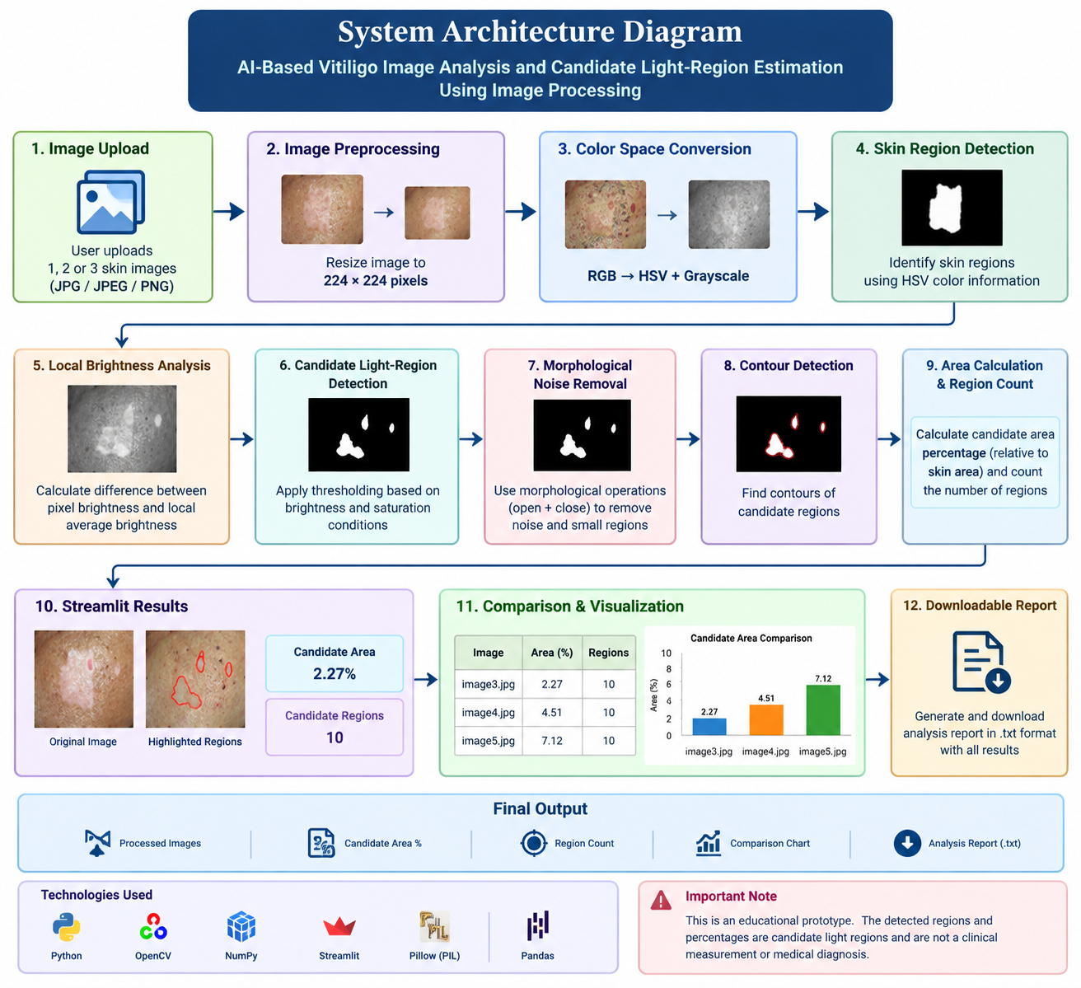
3. System Architecture
AI-Based Vitiligo Image Analysis • Educational Prototype 4

Slide 5
4. Image Processing Workflow
1. Image Upload
2. Preprocessing
Upload 1–3 JPG/JPEG/PNG images.
Resize each image to 224 × 224.
3. Color Analysis
4. Skin Region
Use HSV and grayscale representations.
Create a skin-region mask.
5. Light-Region Detection
6. Noise Removal
Analyze local brightness differences.
Apply morphological operations.
7. Contour Detection
8. Area & Count
Find candidate region contours.
Estimate area percentage and region count.
AI-Based Vitiligo Image Analysis • Educational Prototype 5

Slide 6
5. Technologies Used
Python
OpenCV
NumPy
Main programming language
Image reading, resizing, masking, morphology, contours
Image arrays and numerical operations
Pillow (PIL)
Pandas
Streamlit
Uploaded image handling
Comparison table and result organization
Interactive web interface and report download
AI-Based Vitiligo Image Analysis • Educational Prototype 6

Slide 7
6. Results
Prototype Results
image3.jpg → Estimated Candidate Area: 2.27% | Candidate Regions: 10 image4.jpg → Estimated Candidate Area: 4.51% | Candidate Regions: 10 image5.jpg → Estimated Candidate Area: 7.12% | Candidate Regions: 10 The values are algorithm-generated candidate outputs for educational/project demonstration purposes.
AI-Based Vitiligo Image Analysis • Educational Prototype 7

Slide 8
7. Streamlit User Interface
Main Features
Project Output
• Upload up to three images • View original and highlighted results • Candidate area percentage • Candidate region count • Comparison table • Bar chart visualization • Downloadable text report
The application combines image processing with a simple web interface so that the workflow can be demonstrated easily during a project presentation or viva.
AI-Based Vitiligo Image Analysis • Educational Prototype 8

Slide 9
8. Advantages & Limitations
Advantages
Limitations
• Simple interface • Multiple-image comparison • Numerical candidate-area output • Region counting • Visual comparison chart • Downloadable report • Uses common Python libraries
• Not a medical diagnostic tool • Results depend on lighting and image quality • Threshold-based processing may produce false candidate regions • Current dataset is limited • Percentages are not clinical measurements
AI-Based Vitiligo Image Analysis • Educational Prototype 9

Slide 10
9. Future Scope & Conclusion
Future Scope
Conclusion
• Larger and more diverse datasets • Clinically validated annotated data • Machine learning / deep learning models • More accurate segmentation • Better handling of lighting variation • Image-quality checking • Proper evaluation metrics • Validation with qualified medical professionals before clinical use
The project demonstrates an educational computer-vision workflow for analyzing skin images, identifying candidate light regions, estimating relative area, counting regions, comparing images, and generating reports.
AI-Based Vitiligo Image Analysis • Educational Prototype 10

Slide 11
10. Important Disclaimer
This project is an educational image-processing prototype.
The detected regions and percentages are algorithmic outputs for demonstration.
They are NOT clinical measurements, medical diagnoses, or medical advice.
The system should not be used to make healthcare or treatment decisions.
AI-Based Vitiligo Image Analysis • Educational Prototype 11

Slide 12
Thank You
Thank You
Questions & Discussion
Presented by: Shaik Bibi Arthika
AI-Based Vitiligo Image Analysis • Educational Prototype 12

